Slide 1
Mobbing Basics

Slide 2
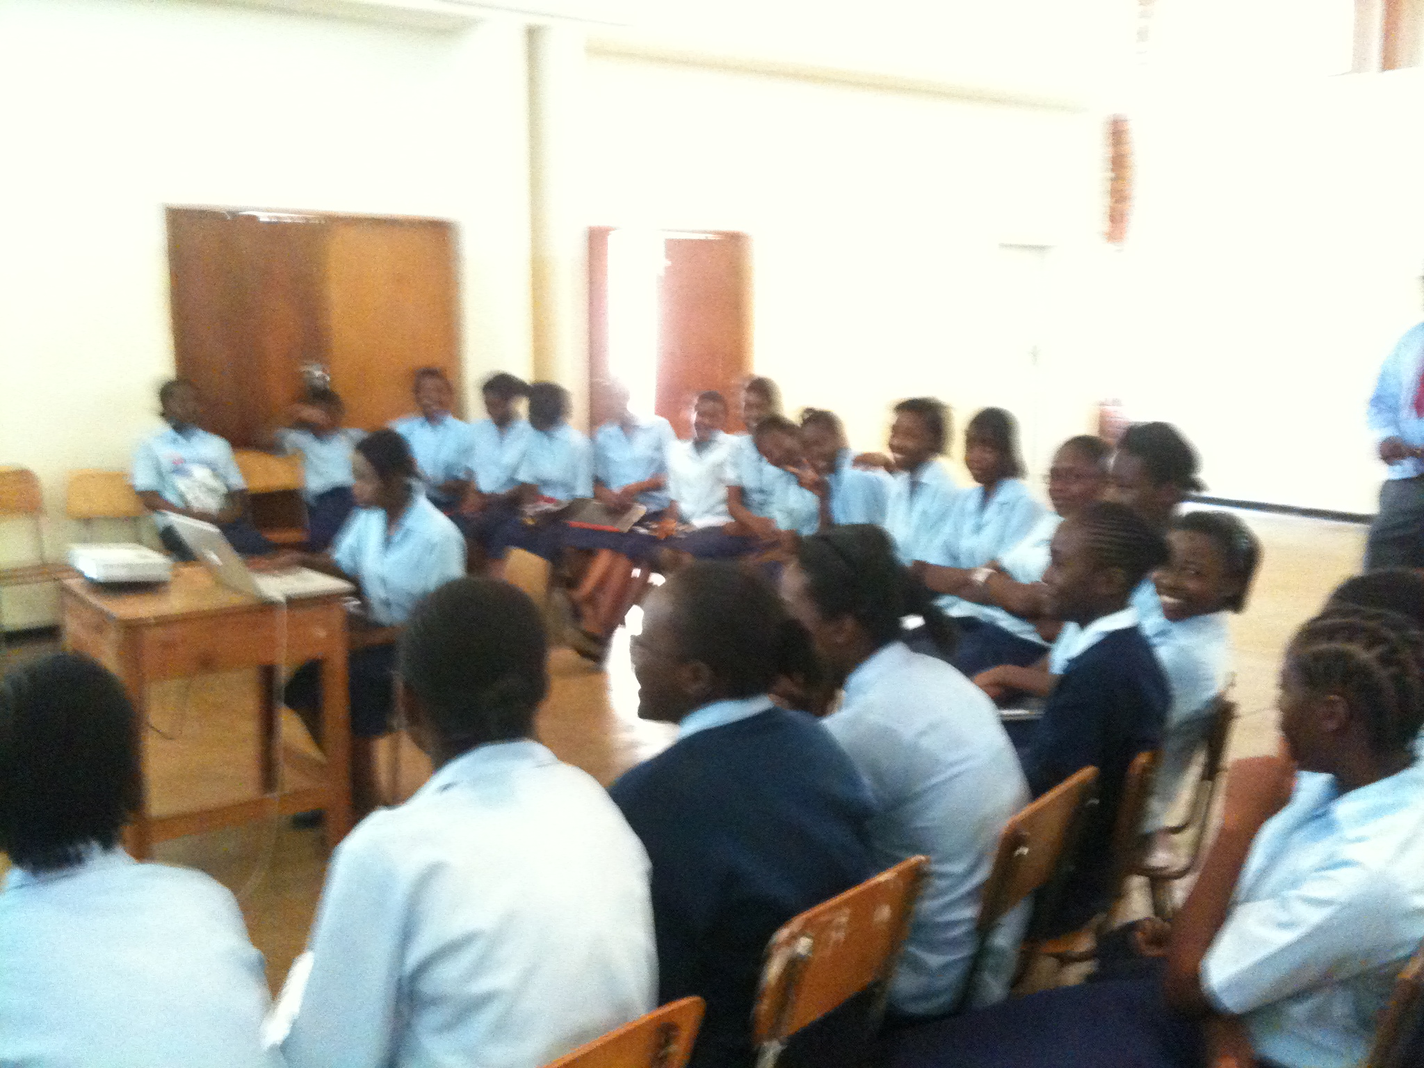

Slide 3
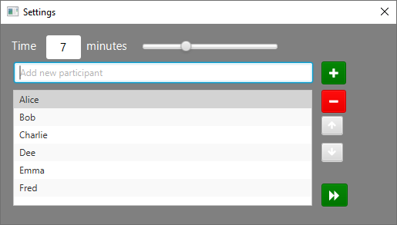
< Alice: I’m Typing
< Bob: I’m Talking
< Charlie: Next

Slide 4
< Bob: I’m Typing
< Charlie: I’m Talking
< Dee: I’m Next

Slide 5
< Charlie: I’m Typing
< Dee: I’m Talking
< Emma: I’m Next

Slide 6
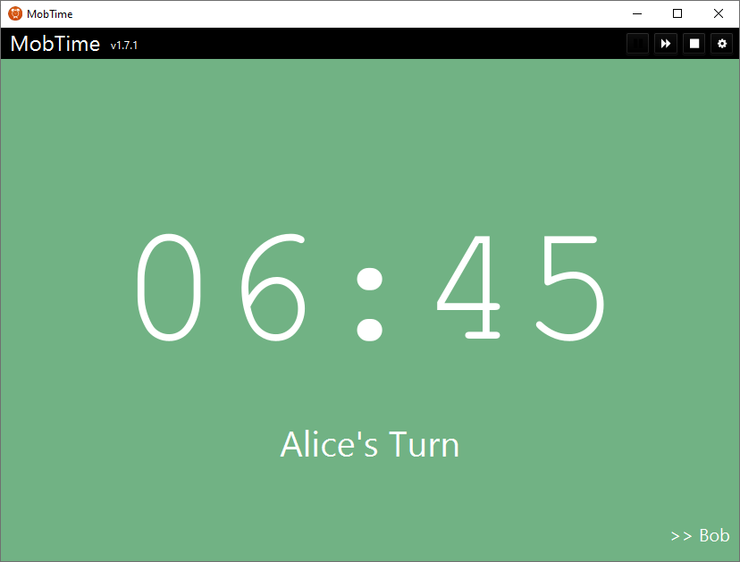
< Alice: I’m Typing
< Bob: I’m Talking
< Charlie: I’m Next

Slide 7
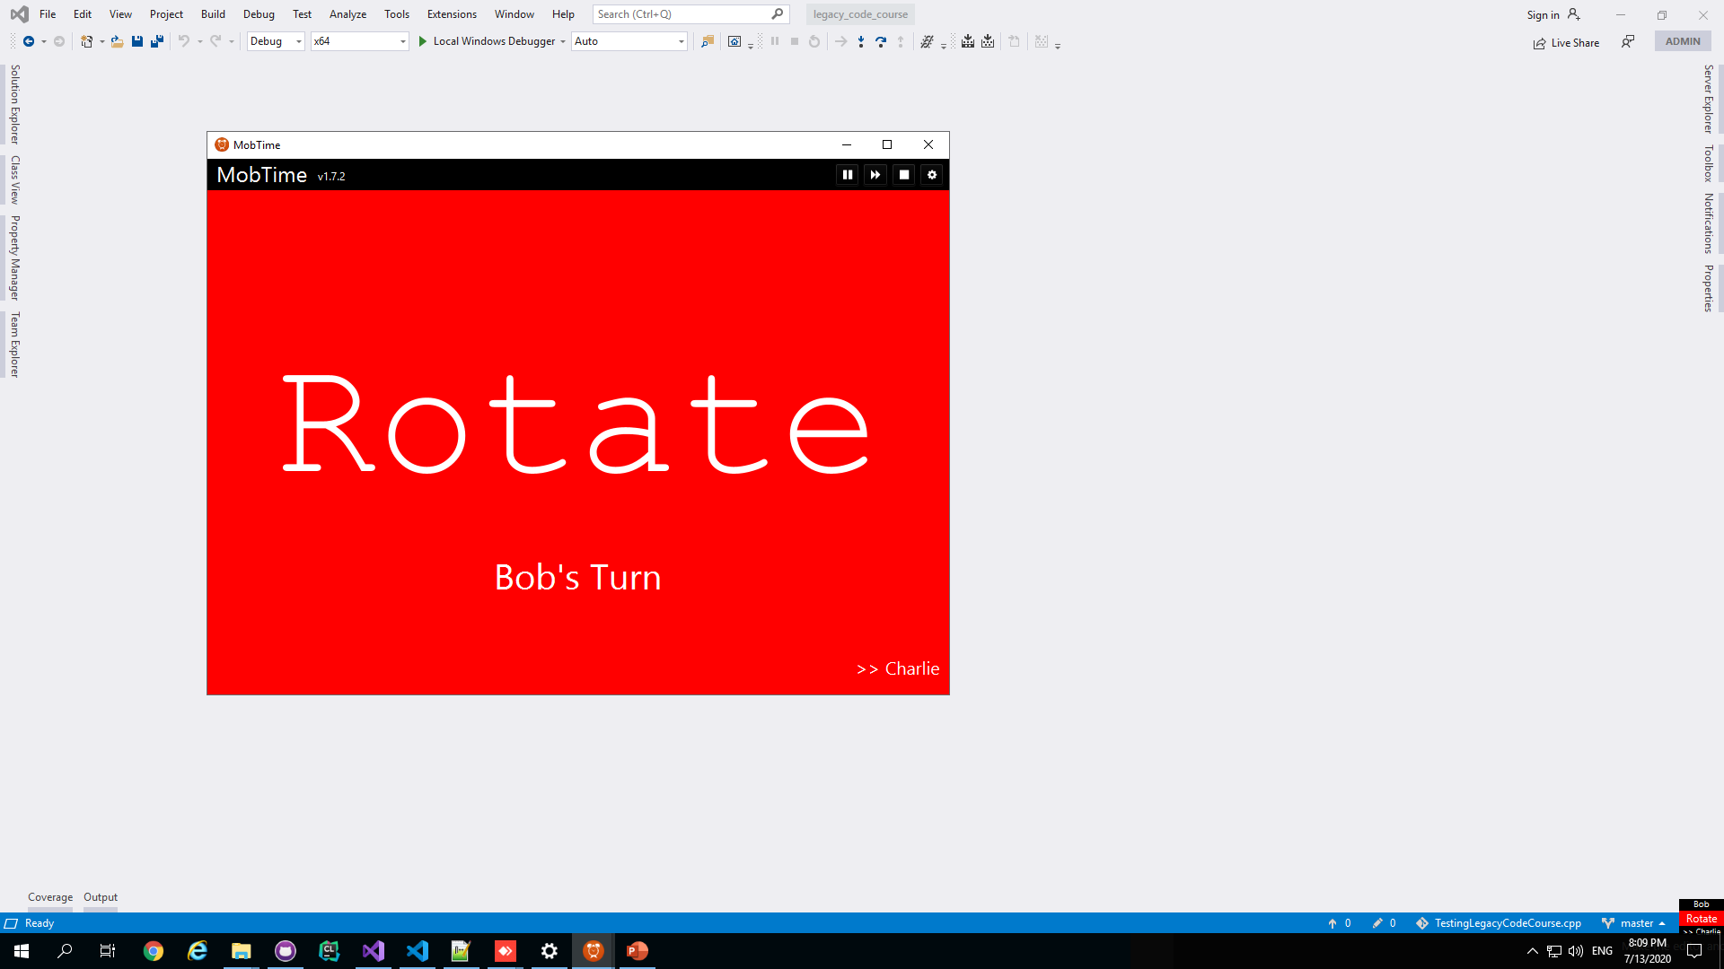

Pause
Main
Ding Dong
Mini
* Bell by richad from the Noun Project

Slide 8
Kindness Consideration & Respect

Slide 9
Intention Location Details

